Slide 1


Quick Refresher on Performance Testing
Bangalore
Pune
Speed : 100 Km/Hour
Duration : 9 hours
Capacity: 5
Latency: 9 Hours
Throughput : 5/9 = ~.56
Low Latency
High Throughput
Bangalore
Pune
Speed : 70 Km/Hour
Duration : 14 hours
Capacity: 50
Latency: 14 Hours.
Through Put: 50/14 = ~3.5
Little’s Law
User Load =Transactions per second * (Response Time + Total Think Time + Pacing)
Or Virtual Users

Slide 2
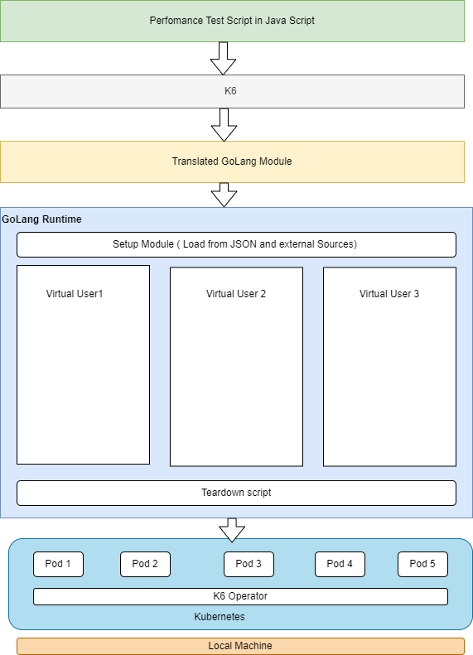
K6 Architecture and Flow
K6 is written in the goja programming language, which is an implementation of ES2015(ES6) JavaScript on pure Golang language.It doesn’t require nodejs
Goja is an implementation of ECMAScript 5.1 in pure Go with emphasis on standard compliance and performance.
Highly Configurable by design since it is script driven and integrated with CI/CD pipelines. Nimble agile teams to perform performance testing.
Virtual users are to used to simulate traffic in testing environment. K6 internally uses gorouting to simulate virtual users. 1 Single instance can hundreds and thousand of users.
Supports distributed load generation using k6 operator. It can run on top of kubernetes as pods.

Slide 3
How to Run K6
K6 Life Cycle
Create a scaffold file.
K6 new
To run k6 script
k6 run
K6 run –vus 10 –duration 10s simple.js
// 1. init code
2
3export function setup() {
4 // 2. setup code
5} Executed initially once , to load test data from external sources
6
7export default function (data) {
8 // 3. VU code
9} Executed initially once , to load test data from external sources Ex
10
11export function teardown{
12 // 4. teardown code
13}

Slide 4
Simulation of Real time traffic
Simulation of real time production data using shared array, faker library.
Simulation of real time execution through the concept of executors.

Slide 5
Simulation of Real time data
Use of faker library for data parameterization.
Connect to external source such as DB, JSON file and create a shared array across virtual users.
Shared Array Constraints – Would not be able to share the data across VU
var data = new SharedArray("colors", function() {
return JSON.parse(open('./customers.json')).customers;
})
Iterations completed: ${exec.instance.iterationsCompleted}
K6 run dp.js

Slide 6
Simulation of Real time Traffic
Simulation of real time traffic by controlling the number of virtual users and iterations.
Configurable via JSON object with executor type, iterations count and count of virtual users.
K6 run executor.js

Slide 7
Custom Metrics
System metrics
Captures the counts of success, failures and trend , percentile of latency ranges.
Custom metrics : To capture the information on authentication failures, bad data failures and business failures.
");
const http403StatusCounter = new Counter("http403StatusCounter");
const http200StatusCounter = new Counter("http200StatusCounter
if (res.status === 200 ) {
http200StatusCounter.add(1);
} else if ( res.status === 403) {
http403StatusCounter.add(1);
}

Slide 8
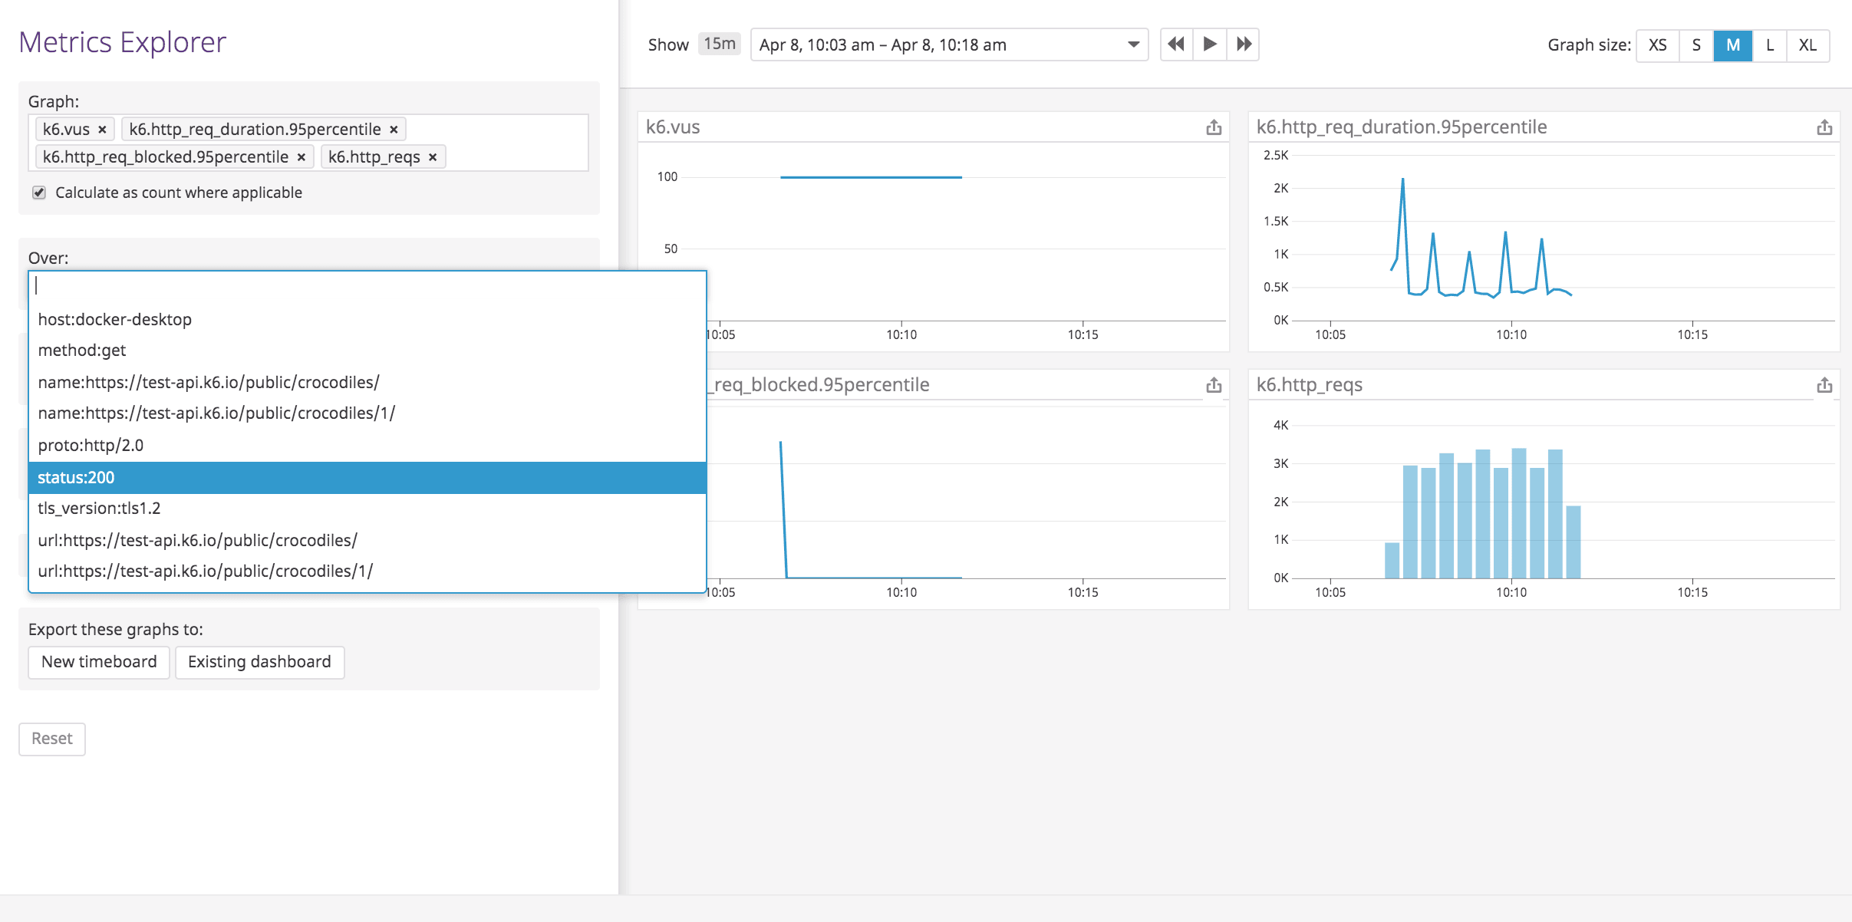
Real time Monitoring of K6 Tests
k6 run --out output-statsd script.js

Slide 9
GitHub Link
https://github.com/sreelakshminarayanan/k6-primer

